Slide 1
GNU/Linux
Open-source operating system
Kernel: core of operating system
Allocates time and memory to programs
Handles file system and communication between software and hardware
Shell: interface between user and kernel
Interprets commands user types in
Takes necessary action to cause commands to be carried out
Programs

Slide 2
Files and Processes
Everything is either a process or a file:
Process: an executing program identified by PID
File: collection of data
A document
Text of program written in high-level language
Executable
Directory
Devices

Slide 3
Linux File System Layout
Tree structured hierarchy
/
root
bin
dev
home
usr
tmp
lakers
celtics
bulls
lib
README
music
doc
game1
game2
Notes:
Each file is under a directory.
A directory is also a file.
Only one root “/”.
Regular files can only be leaves.
e.g., documents, music, etc.

Slide 4
Absolute Path vs. Relative Path
root
/
bin
dev
home
usr
tmp
lakers
celtics
bulls
lib
README
music
doc
game1
game2
Current directory: home

Slide 5
The Basics: Moving Around
pwd: print working directory
cd: change directory
~ home directory
. current directory
/ root directory, or directory separator
.. parent directory

Slide 6
The Basics: Shell
<up arrow>: previous command
<tab>: auto-complete
!!: replace with previous command
![str]: refer to previous command with str
Notes:
PAUSE and ask next slide commands

Slide 7
The Basics: Dealing with Files
mv: move/rename a file
cp: copy a file
rm: remove a file
r: remove directories and their contents recursively
mkdir: make a directory
rmdir: remove an empty directory
ls: list contents of a directory
d: list only directories
a: list all files including hidden ones
l: show long listing including permission info
s: show size of each file, in blocks

Slide 8
Linux File Permissions

Slide 9
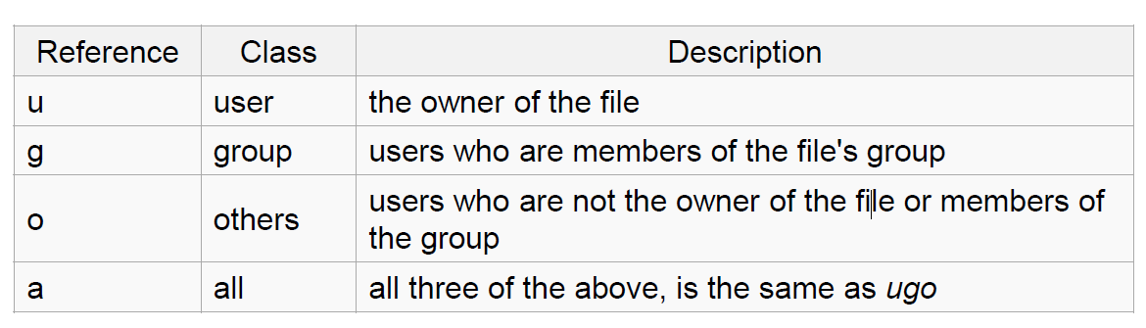
Linux File Permissions
chmod
read (r), write (w), executable (x)
User, group, others

Slide 10
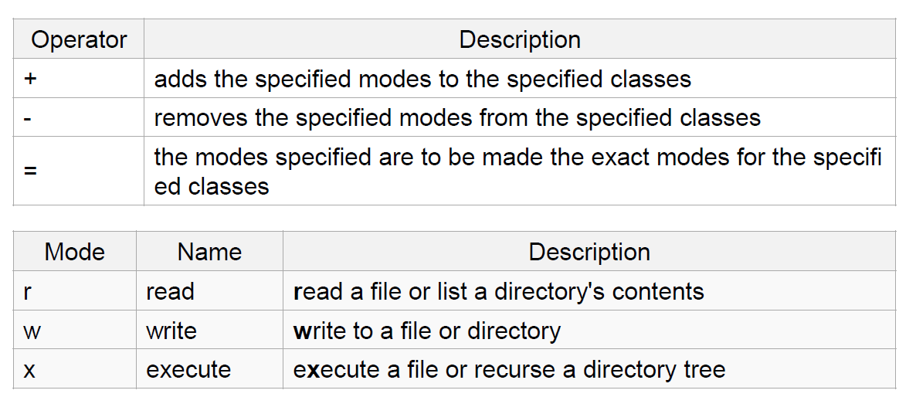
The Basics: chmod (symbolic)

Slide 11
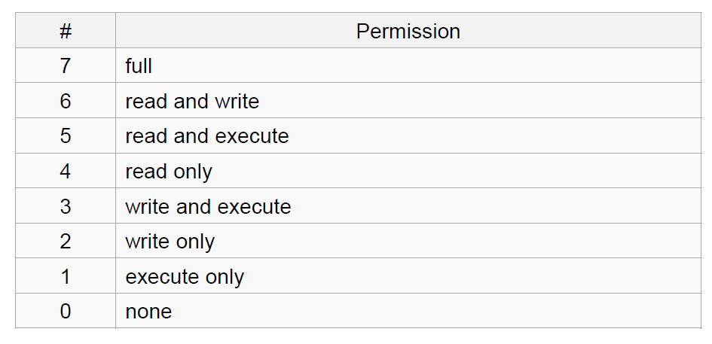
The Basics: chmod (numeric)
Usage
– chmod [''references''][''operator''][''modes''] ''file1'' ...
Example: chmod ug+rw mydir, chmod a-w myfile,
Example: chmod ug=rx mydir, chmod 664 myfile

Slide 12
The Basics: find
-type: type of a file (e.g: directory, symbolic link)
-perm: permission of a file
-name: name of a file
-user: owner of a file
-maxdepth: how many levels to search

Slide 13
File Name Matching
?: matches any single character in a filename
*: matches one or more characters in a filename
[]: matches any one of the characters between the brackets. Use ‘-’ to separate a range of consecutive characters.

Slide 14
find Examples
Examples
find . -name my*
find . -name my* -type f
find / -type f -name myfile –print

Slide 15
man
Extensive documentation that comes preinstalled with almost all substantial Unix and Unix-like operating systems
Usage
read a manual page for a Linux command
man <command_name>
man section command_name
1 User Commands 2 System Calls 3 C Library Functions 4 Devices and Special Files 5 File Formats and Conventions 6 Games et. al. 7 Miscellanea 8 System Administration tools and Daemons
Hit “q” to get out of man page

Slide 16
wh… Commands
whatis <command>: returns Name section of man page
whereis <command>: locates the binary, source, and manual page files for a command

Slide 17
More Basics: Look these up
cat
head
tail
du
ps
kill
diff
cmp
wc
sort

